Slide 1
Maximizing Speedup through Self-Tuning of Processor Allocation
Presenter : Hyuk-Jing Jeong, Inyong Lee
Notes:
Hello, my name is Hyuk-jin jeong, I and Inyong Lee will present the paper named “Maximizing speedup through ~”

Slide 2
Contents
Introduction
Experimental Environments
Self-Tuning Algorithms
Multi-Phase Self-Tuning Algorithms
Conclusion
Notes:
At first, I will briefly introduce the author’s approach named self tuning.
This approach heavily depends on hardware architecture, so next, I will explain experimental environments, and self-tuning algorithms.
After that, Inyong will explain the advanced version of the self-tuning algorithms and conclude the presentation

Slide 3
Introduction

Slide 4
How to maximize the speedup of a parallel Job?
More processors do not lead to more speedup
Optimal processor number for a job ($P_{opt}$) will be
$$1 ≤ P_{opt} ≤P(Max number of processors)$$
No static processor allocation may be optimal
A job’s speedup may vary as its execution evolves over time
Author’s Solution : Dynamically determine the number of processors → Self-tuning
Notes:
Authors focused on maximizing the speedup of parallel jobs.
They observed speedup does not increase monotonically as the number of processors increases,
Which means more processors do not lead to more speedup.
So we need to find out optimal processor numbers between 1 and maximum number of processors
To do so, maybe we can try static processor allocation, but it is not optimal because a job’s speedup changes over its execution
So the authors suggest to determine the number of processors dynamically, and this is called self-tuning.

Slide 5
Self-Tuning Overview
Self-Tuning iteratively performs 3 steps
1. Dynamically measure job efficiencies (E(p)) at different processor allocations
2. Calculate speedup (S(p))
3. Adjust a job’s processor allocation to maximize speedup
Notes:
This slide describes the overview of self-tuning
Self-tuning iteratively performs 3 steps
First, we measure job efficiencies at different processor allocations at runtime
Second, we calculate the speedup from job efficiencies
At last, we adjust a job’s processor allocation to maximize speedup
Authors depend on hardware support to measure job efficiencies, so I will first explain the experimental environment.

Slide 6
Experimental Environment

Slide 7
Experimental environment
KSR-2 COMA shared memory multiprocessor (supercomputer)
KSR-2 provides a tool named event monitor which measures runtime information such as,
Elapsed execution time
Accumulated user-mode execution time
Accumulated idle time
Accumulated processor stall time
10 parallel applications
Manually instrumented the apps to measure runtime information using the event monitor

Slide 8

Measuring Job Efficiency & Calculating Speedup
Max job efficiency : 1
4 well-known factors that reduce job efficiency
Parallelization overhead (typically small)
System overhead
Idleness
Communication ($≈$ processor stall)
Measureable factors
WT(p) : Elapsed execution time
UT(p) : User-mode execution time
IT(p) : Idle time
PST(p) : Processor stall time
Efficiency :
(processor p)
System overhead
Idleness
Processor stall
Speedup :
(processor p)

Slide 9
Self-Tuning Algorithm
Notes:
Now, we can calculate the speedup, next step will be maximizing the speedup by adjusting the number of processors

Slide 10
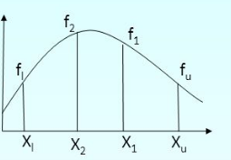
Basic Self-Tuning Algorithm (1)
Assumption
Speedup is a single variable function, S(p) : I → R with domain [1,P]
S(p) can be calculated by measuring E(p) for any one iteration
Single variable optimization problem
Adjustable factor : # of processors
Goal : Maximize Speedup
Observation
Most speedup functions are unimodal
Speedup
# of processors

Slide 11
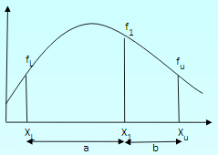
Basic Self-Tuning Algorithm (2)
MGS (Method of Golden Section)
Iterative method to find out the extremum of a unimodal function
At first, we measure S(1), and S(P). (P : maximum # of processors)
And then, we measure an intermediate point (f1) which divides the interval [1~P] by golden ratio (0.618)
It is known that the ratio will efficiently find out the extremum
Now we have 3 data (fL, f1, fu) and max point will be in [XL~Xu]
Speedup
Xl : 1
Xu : P
# of processors
b/a = 0.618
Source : http://nm.mathforcollege.com
Notes:
만약, XL과 X2 사이에서 fL보다 적은 값(fk) 나오면 (non-unimodal), 그냥 unimodal한 것처럼 되도록 range 설정해서 continue (fk, f2, f1), interva은 [Xk~f1]

Slide 12
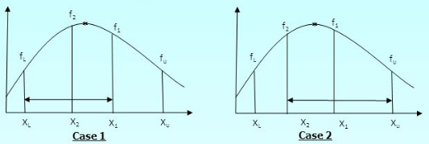
Basic Self-Tuning Algorithm (3)
Next, we measure f2 located on the symmetry of f1
Case 1 (f2 > f1)
max point will be in [XL ~ X1], point for next iteration : (fL, f2, f1)
Case 2 (f2 < f1)
max point will be in [X2 ~ Xu], point for next iteration : (f2, f1, fu)
Speedup
Speedup
# of processors
# of processors
Source : http://nm.mathforcollege.com
Notes:
만약, XL과 X2 사이에서 fL보다 적은 값(fk) 나오면 (non-unimodal), 그냥 unimodal한 것처럼 되도록 range 설정해서 continue (fk, f2, f1), interva은 [Xk~f1]

Slide 13
Basic Self-Tuning Algorithm (4)
A heuristic algorithm for non-unimodal case
If we encounter a new data (f3) which indicates the function is not unimodal, then we continue with the largest sub-interval conformal with a unimodal function [f3~f1]
Speedup
f3
# of processors

Slide 14
Basic Self-Tuning Algorithm Assumption
Non-unimodal speedup function Case
Heuristic-based extended MGS search procedure will correctly locate global maximum
Speedup assumption
The basic procedure assumes about job’s latter behavior with speedup values at the beginning of execution
But, speedup is independent with time. So allocation found may not be so appropriate in later
Speedup values of successive iterations will vary to some degree

Slide 15
Refined Self-tuning approach
Change-driven self-tuning
Continuously monitors job efficiency and re-initiates the search procedure whenever it notices a significant change in efficiency
Accords to a predefined threshold value
Time-driven self-tuning
Useful when job efficiency changes in the middle of self-tuning search but stabilizes before the search completes
Includes the change-driven approach and rerun the search procedure periodically

Slide 16
Performance
Notes:
Now, we can calculate the speedup, next step will be maximizing the speedup by adjusting the number of processors

Slide 17
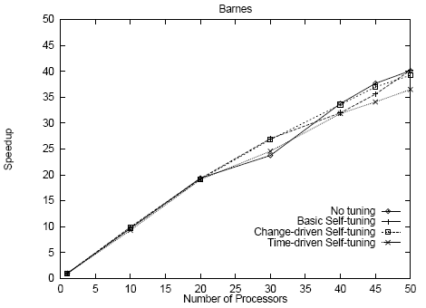
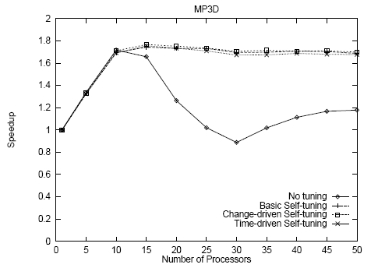
Performance
Self-tuning imposes very little overhead
Basic self-tuning is significantly better than no-tuning

Slide 18
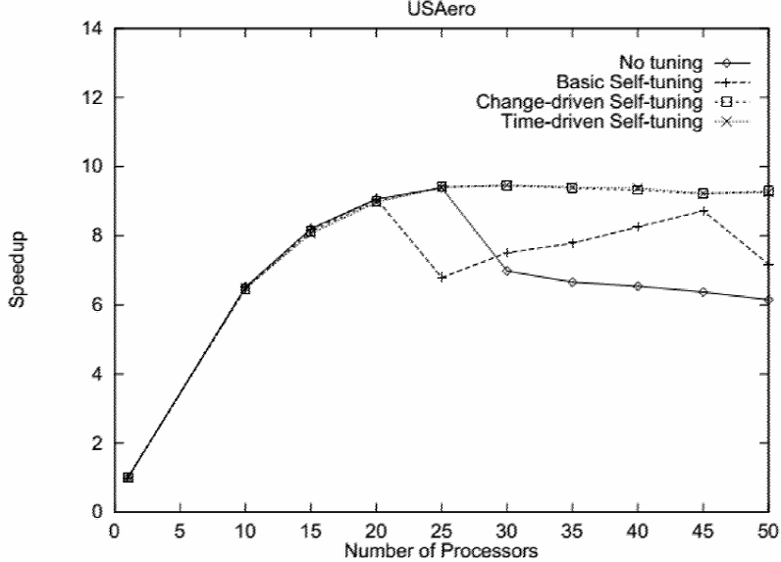
Performance
Change-driven self-tuning can significantly improve performance over basic self-tuning

Slide 19
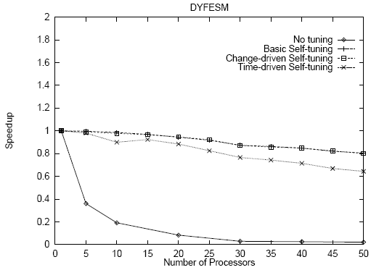
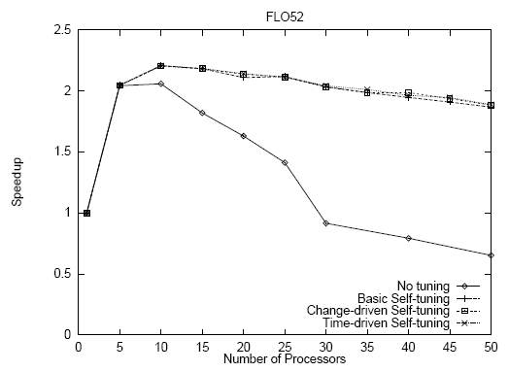
Performance
Time-driven self-tuning is not useful for the programs here
The performance benefit of self-tuning can be limited by the cost of probes

Slide 20
Multi-phase Self-tuning
Notes:
Now, we can calculate the speedup, next step will be maximizing the speedup by adjusting the number of processors

Slide 21
Problem of refined self-tuning approach
The iterations of some applications are composed of multiple parallel phases
Phase
A specific piece of code
e.g. parallel loop in a compiler-parallelized program
Each phase may be executed or not depending on the outcome of conditional expressions and sequential loop

Slide 22
Problem of refined self-tuning approach
Extension of problem
Assume that on each try to and exit from a phase, the runtime system is provided with the unique ID of the phase
Find a processor allocation vector (p1, p2, …, pn) that maximizes performance when there are n phases in an iteration

Slide 23
Multi-phase Self-tuning (1)
Independent multi-phase self-tuning (IMPST)
Merely apply basic self-tuning to each phase independently
Simple
Problem : Performance of each phase ALSO depends on the allocations for other phases.

Slide 24
Multi-phase Self-tuning (2)
Inter-dependent multi-phase self-tuning (DMPST)
Simulated annealing and a heuristic-based approach
Randomized search technique
Choosing an initial candidate allocation vector
Selecting a new candidate vector (random multiplied)
Evaluating and accepting new candidate vectors until steady state
Terminating the search

Slide 25
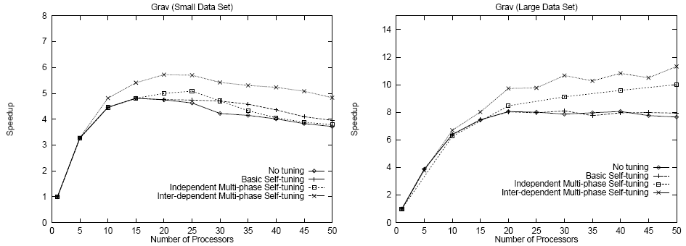
Multi-phase Self-tuning
Multi-phase techniques are able to achieve performance not realizable by any fixed allocation
Inter-dependent self-tuning yields better performance than any other

Slide 26
Conclusion
Maximizing application speedup through runtime, self-selection of an appropriate number of processors on which to run
Based on ability to measure program inefficiencies
Simple search procedures can automatically select appropriate numbers of processors
Relieves the user from the burden of determining the precise number of processors to use for each input data set
Potential to outperform any static allocation

